Slide 1

TAG 02/11/2021
The Joy of MicroPython

Slide 2

An Alternative for Microcontroller Programming
Arduino-style microcontrollers are popular for ham radio applications, robotics, and home control. Programming is usually done with the Arduino IDE (integrated development environment) using C++.
Until recently, C++ was about the only mainstream programming language available for programming microcontrollers. We now also have MicroPython, thanks in large part to the work of Damien George (creator), Limor Fried (owner of Adafruit), Rui Santos (popular on-line tutorial author)
MicroPython was created as a Kickstarter project in 2013, so it has not been around long.
Graphic from ADAFRUIT.COM

Slide 3

Why use it instead of C++?
Python is often the first and only college-level programming class people take. STEM students are often exposed to Python. MicroPython opens microcontroller programming up to more people.
Python is a bit more readable that C++ and has built-in exception and error handling (like the BASIC you may have used decades ago).
Python is less crash-prone and handles Strings and Data Structure at a higher level.
Raspberry Pi programming is usually done in Python.
Python Book on Amazon

Slide 4
C++ vs Python
String CalculateIAQ(int score)
{
String IAQ_text = "Air quality is ";
score = (100 - score) * 5;
if (score >= 301)
{
IAQ_text += "Hazardous";
IAQ_Score = "Hazardous";
}
else if (score >= 201 && score <= 300)
{
IAQ_text += "Very Unhealthy";
IAQ_Score = "Very Unhealthy";
}
else if (score >= 176 && score <= 200)
{
IAQ_text += "Unhealthy";
IAQ_Score = "Unhealthy";
}
else if (score >= 151 && score <= 175)
{
IAQ_text += "Unhealthy for Sensitive Groups";
IAQ_Score = "Unhealthy for Sensitive Groups";
}
else if (score >= 51 && score <= 150)
{
IAQ_text += "Moderate";
IAQ_Score = "Moderate";
}
else if (score >= 00 && score <= 50)
{
IAQ_text += "Good";
IAQ_Score = "Good";
}
Serial.print("IAQ Score = " + String(score) + ", ");
return IAQ_text; }
def iqa(self):
score = self.iqa_score
IQA_text = “ “
print ( 'IQA score ' + str( round(score,1) ) )
score =int(score)
if score >= 301:
IAQ_text = "Hazardous"
elif (score >= 201) and (score <= 300):
IAQ_text = "Very Unhealthy"
elif (score >= 176) and (score <= 200):
IAQ_text = "Unhealthy"
elif (score >= 151) and (score <= 175):
IAQ_text = "Unhealthy for Sensitive Groups"
elif (score >= 51) and (score <= 150):
IAQ_text = "Moderate"
elif (score >= 00) and (score <= 50):
IAQ_text = "Good"
return IAQ_text

Slide 5
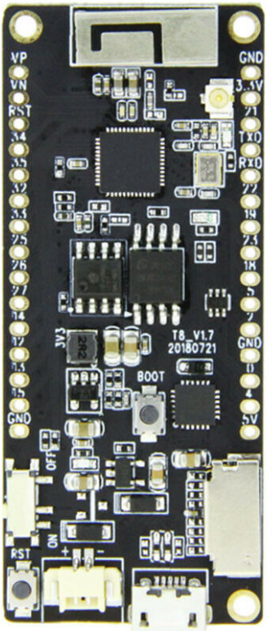
The Downside of MicroPython
Compared to the Arduino’s C++, few libraries exist.
You must use a buggy Integrated Development Environment
It takes up a lot of memory. You can't use it on an Arduino. It barely works on an ESP8266. Your best bet is an ESP32 with extra PSRAM (pseudo static RAM).
The user base is still somewhat small and the sources for getting help are limited.
Software and hardware are still in a state of flux.
There is really nothing wrong with C++. MicroPython may be a solution in search of a problem.
ESP32-WROVER T8 V1.7

Slide 6
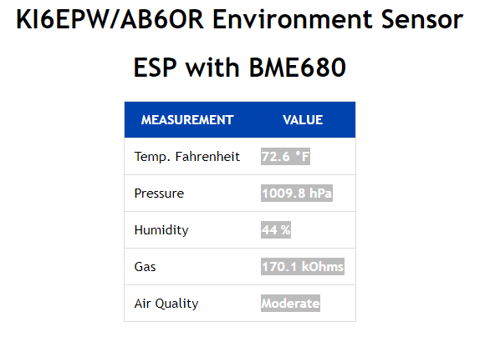
Does It Work?
Yes, it worked great!
Here is a web site that gives interior environmental conditions. It is running on an ESP32 with a temperature, humidity, pressure and air quality sensor attached.
KI6EPW/AB6OR Air Quality Station

Slide 7
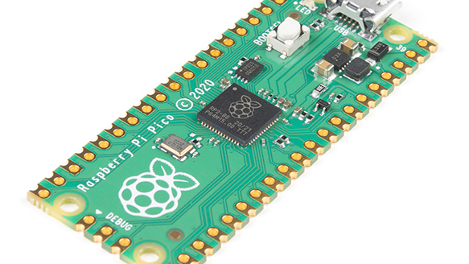
New Raspberry PI - PICO
The Raspberry Pi Foundation created their own microcontroller designed for MicroPython.

Slide 8

That’s it (except for the unrelated photo)
I hope you found this interesting. Even if you don’t have any use for this now, you may in the future.
Here is a link to the code.
Here is a link to the presentation.
Conjunction of Jupiter and Saturn 2020

